Slide 1
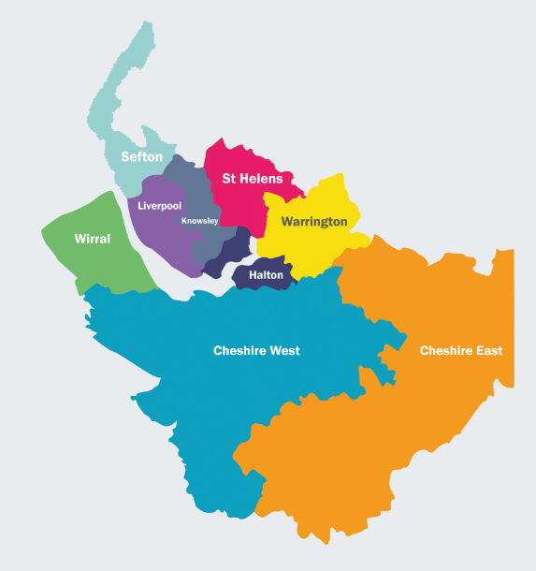


Cheshire and Merseyside Women’s Health Strategy
Executive Summary
‘We want all women, babies and families to have the best start in life and get the support they need to stay healthy and live longer’

Slide 2

Contents
This document is written for local women and girls and describes our plan for improving the health and wellbeing of our communities, our staff and partners across the whole system. It describes our strategy for the next 3 years from September 2023.
Foreword
Executive Summary
Our Partners and Partnership Working
Developing our Strategy: Our Engagement and Collaboration Approach
Cheshire & Merseyside Context
    5.1 Our Population
    5.1 Local System Challenges
Women’s Health: Our Strategy & 12-month Plan
Women’s Health: Cross-cutting Themes
Women’s Health: Our Priorities
Ensuring Value, Safety and Service Effectiveness
Growing, Retaining and Supporting our Workforce
Women’s Health: Delivering our plan
Appendices

Slide 3

Introduction
Why do we need a Women’s Health Strategy
While women in the UK on average live longer than men, women spend a significantly greater proportion of their lives in ill health and disability when compared with men^{3.} And while women make up 51% of the population, historically the health and care system has been designed by men, for men.
Not enough is known about conditions that only affect women, for example menopause or endometriosis or about how conditions that affect both men and women impact them in different ways. For example, cardiovascular disease, dementia, or mental health conditions.
It has also resulted in inefficiencies in how services are delivered, for example we know that many women have to move from service to service to have their reproductive health needs met, and women can struggle to access basic services such as contraception.
The impact of failing to put women at the heart of health services has been clear to see through the number of recent high profile independent reports and inquiries.
Following the National call for evidence in 2021, our Women’s Health survey identified that not being listened to or taken seriously was identified as an issue by over 70% of respondents.
The intent of our Women’s Health Strategy is to make clear what must change to improve health and social outcomes, and health services for all women and girls in Cheshire and Merseyside, and to radically improve the way in which the health and care system engages and listens to all women and girls.
³ONS, Health state life expectancies: UK: 2018 to 2020, published March 2022
“When we get it right for women, everyone in our society benefits”
– Professor Dame Lesley Regan, National Women’s Strategy August 2022

Slide 4
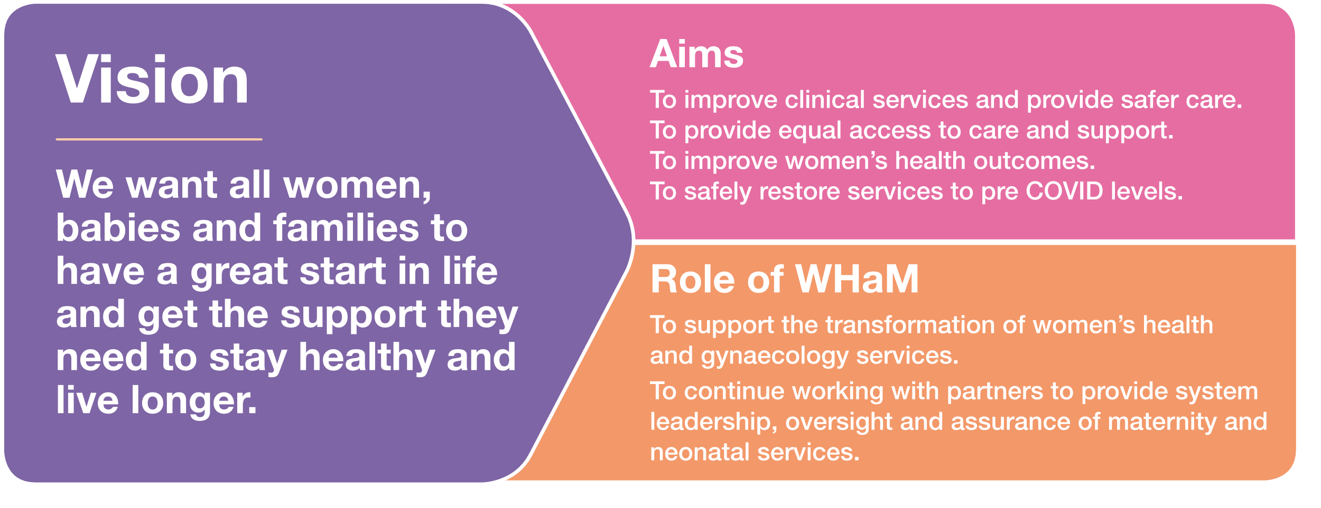
Introduction
Aim of our Women’s Health Strategy
Describes how we will work together with local women and our key partners to deliver the actions we will take over the next 3 years. This is a long-term commitment to reducing health inequalities for women in Cheshire & Merseyside.
Our partners include education, social care, the police, local authorities, housing, third sector, fire and rescue. There is also a strong and engaged Voluntary, Community, Faith, and Social Enterprise (VCFSE) sector supported by local NHS organisations.
To outline the priorities and actions to improve women and girls’ health and healthcare services whilst addressing the health and social inequalities for all women and girls and those in need of women’s health services.
We refer to women and girls throughout this strategy, we are also including all those born female and all those who may need to access Women’s Health services across their life course.
Women’s health outcomes impact not only on individual women and their families, but the healthy functioning of society. Everyone has a part to play in achieving this goal.
Notes:
Reference JFP
Womens Health and Maternity programme – focussing on women’s health strategy – response to Women’s Health Strategy. Our response to the national strategy.
2 events focussing on womens health - keeley
Importance of having a WHaM strategy clearly defined and communicated
The approach we have adopted in producing this strategy (what it has been informed by and who it has involved)
To demonstrate the partnership and collective engagement and ownership across the footprint in both developing and delivering the strategy
Continuously pursuing improvements in women’s health
Outlining any statutory duties or obligations?
In the 2014 chief medical officer’s annual report - The health of the 51%: women1 - we identified the widening disparities for girls and women during their adolescent, reproductive and post-reproductive years. The issues raised then remain relevant today, and in some cases health disparities have widened and been further exaggerated by the pandemic. The Better for Women report published in 2019 by the Royal College of Obstetricians and Gynaecologists highlighted the need to adopt a life course approach, emphasising the importance of preventative health interventions, instead of focussing on the treatment of established disease.2

Slide 5
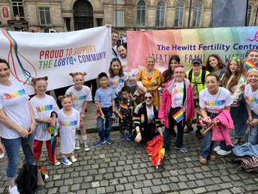
Promoting Inclusivity
To actively promote inclusivity, healthcare services are embracing a more diverse range of terminology that reflects the identities and experiences of local people. This may include using gender-neutral or non-binary terms and delivering culturally competent care that respects individual preferences for gender identity recognition.
We encourage healthcare professionals and institutions to remain open to ongoing learning, engage in respectful dialogue, and adapt their practices to ensure inclusivity. By prioritising inclusivity, we strive to enhance health and social outcomes, and advocate for a society where everyone, regardless of their gender, identity, age or class can access the care they require.
We have developed a set of inclusivity statements shown opposite to ensure that we create an environment where everyone feels seen, heard, and valued, ensuring their healthcare needs are met with sensitivity and understanding.
Statement 1:
In healthcare, we are actively seeking to become more inclusive by using a range of terms to address individuals' gender identities. While we continue to use the term "woman," we also recognise and respect the diverse spectrum of gender identities and strive to co-design services that are accessible and inclusive to all.
Statement 2:
In healthcare, there is a growing recognition that the term "woman" may not encompass the full spectrum of gender diversity. Efforts are being made to be more inclusive by using gender-neutral or non-binary terms and providing culturally competent care. The goal is to ensure that all individuals, regardless of their gender identity, feel valued and receive the healthcare they need.
Statement 3:
In policy documents, it is acknowledged that the terms "woman" and "women" are commonly used to address individuals within a specific context. However, it is important to recognise and respect that gender is a diverse spectrum. Efforts are being made to ensure that policy documents also incorporate inclusive language that encompasses individuals of all gender identities, while still acknowledging the specific needs and experiences of women.
Statement 4:
In healthcare, we are committed to fostering inclusivity and providing equitable services to all individuals. We recognise the unique healthcare needs and experiences of every person, irrespective of their gender identity or assigned sex at birth.

Slide 6
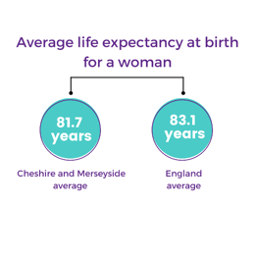
Our Population
The Cheshire and Merseyside locality sits within the third largest Integrated Care System (ICS) in the country.
It is a region with a large and diverse geographical footprint with a mix of urban and rural communities. This presents different challenges in relation to social isolation, limited public transport, increased fuel poverty and loneliness.
Cheshire and Merseyside has a total population of 2.5 million. The population gender split is 1.29m female (51.6%) and 1.21m male (48.4%).
The Cheshire and Merseyside footprint also has diverse communities made up of different ethnic groups and speakers of other languages.
There are 545,000 women across Cheshire and Merseyside of childbearing age (between 16 years to 45 years).
The Office for National Statistics data paints a clear picture of how women’s life expectancy at birth varies by almost eight years across England, ranging from 78.7 years in the most-deprived areas to 86.4 years in the least.

Slide 7

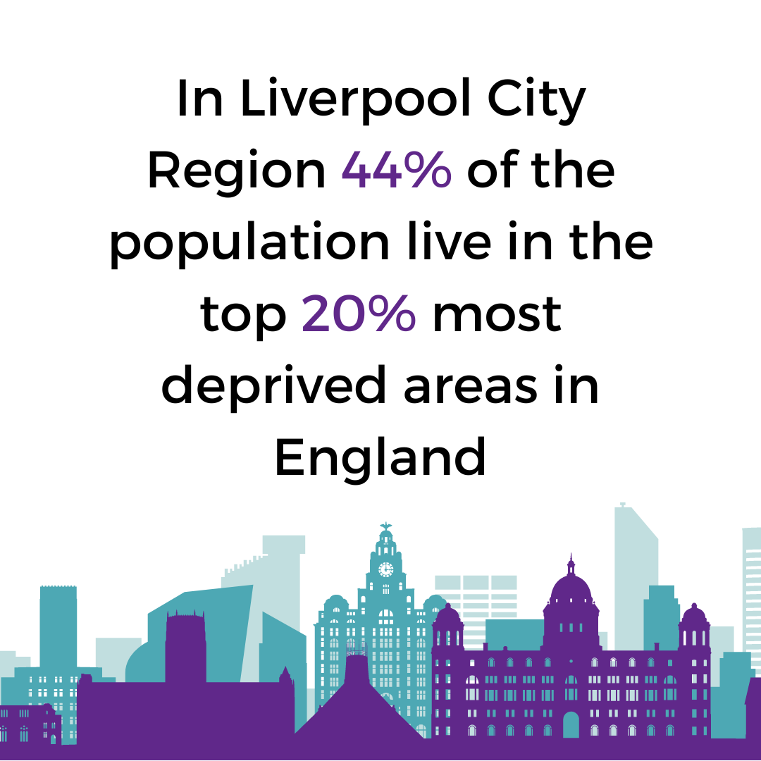
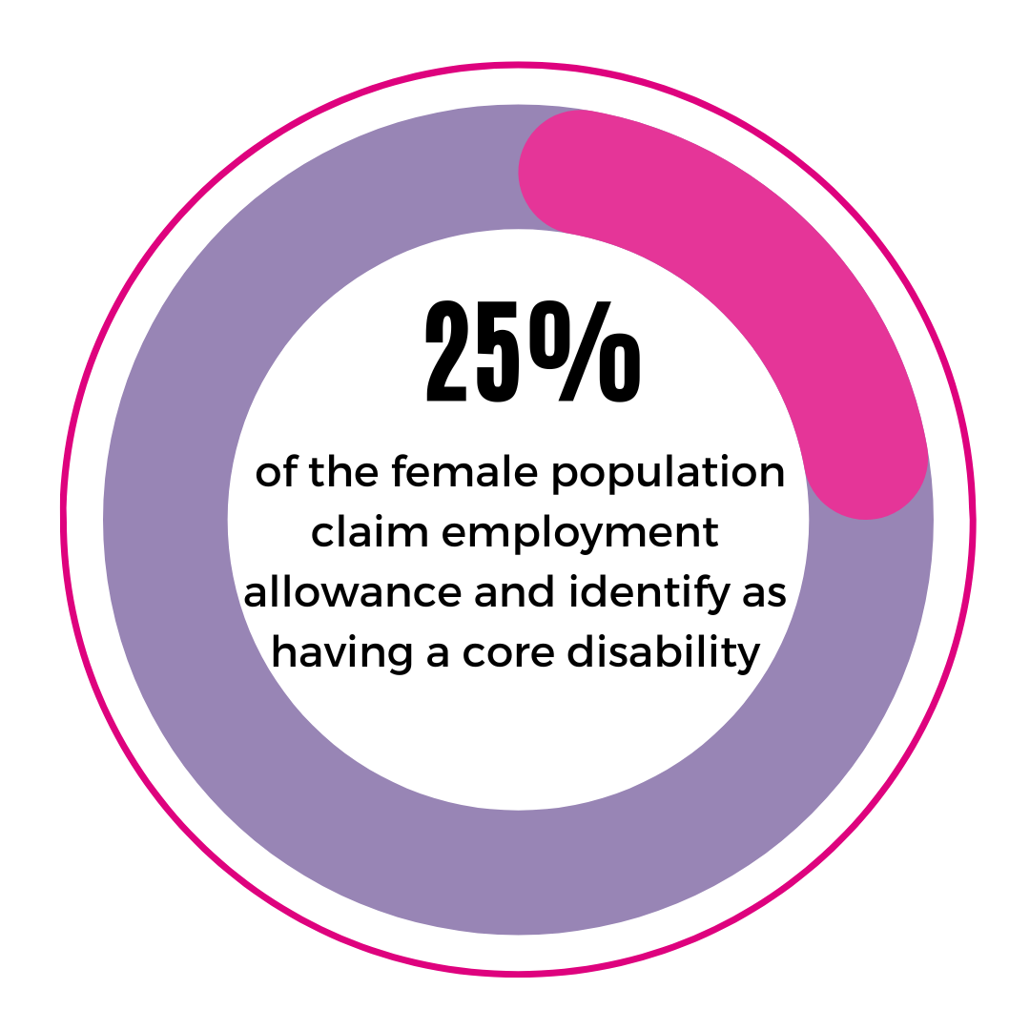
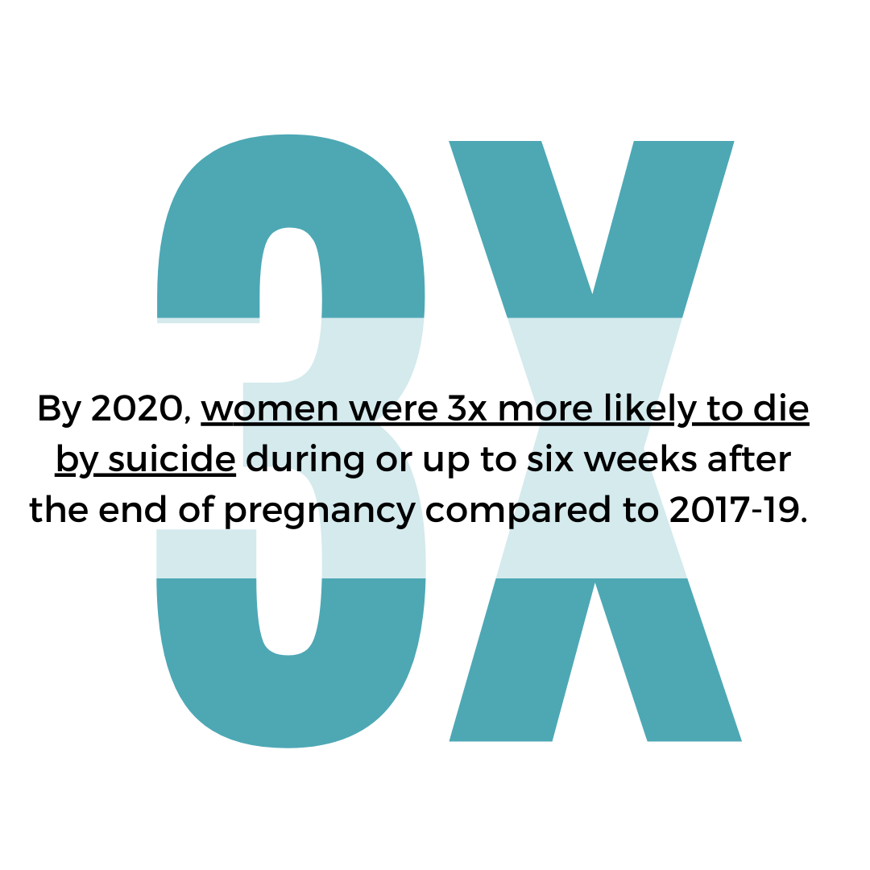
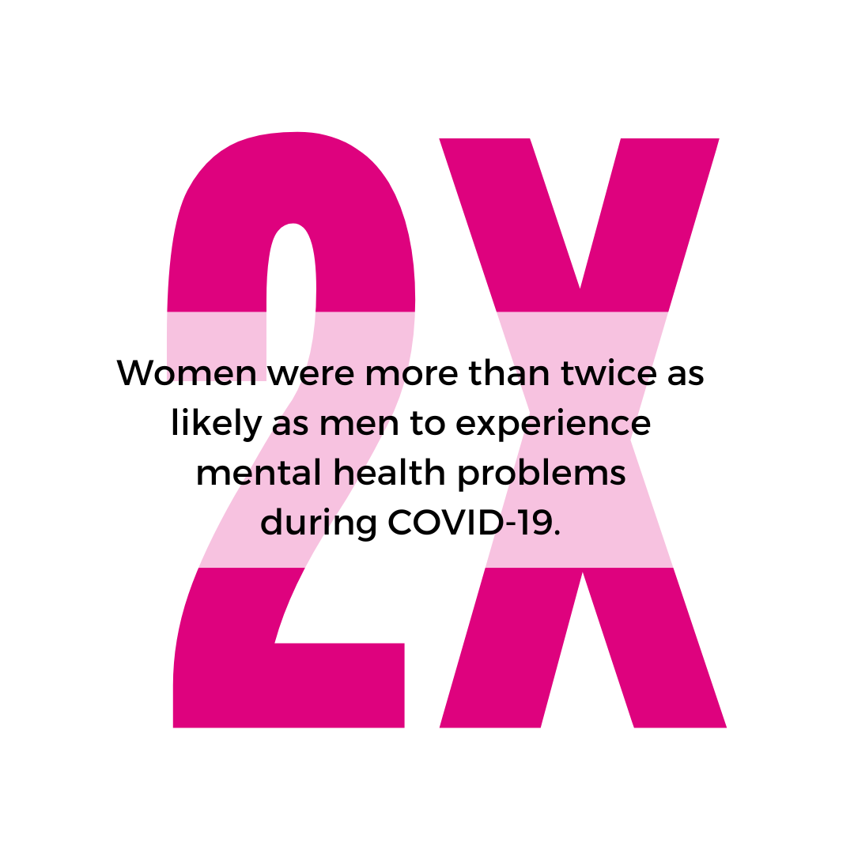
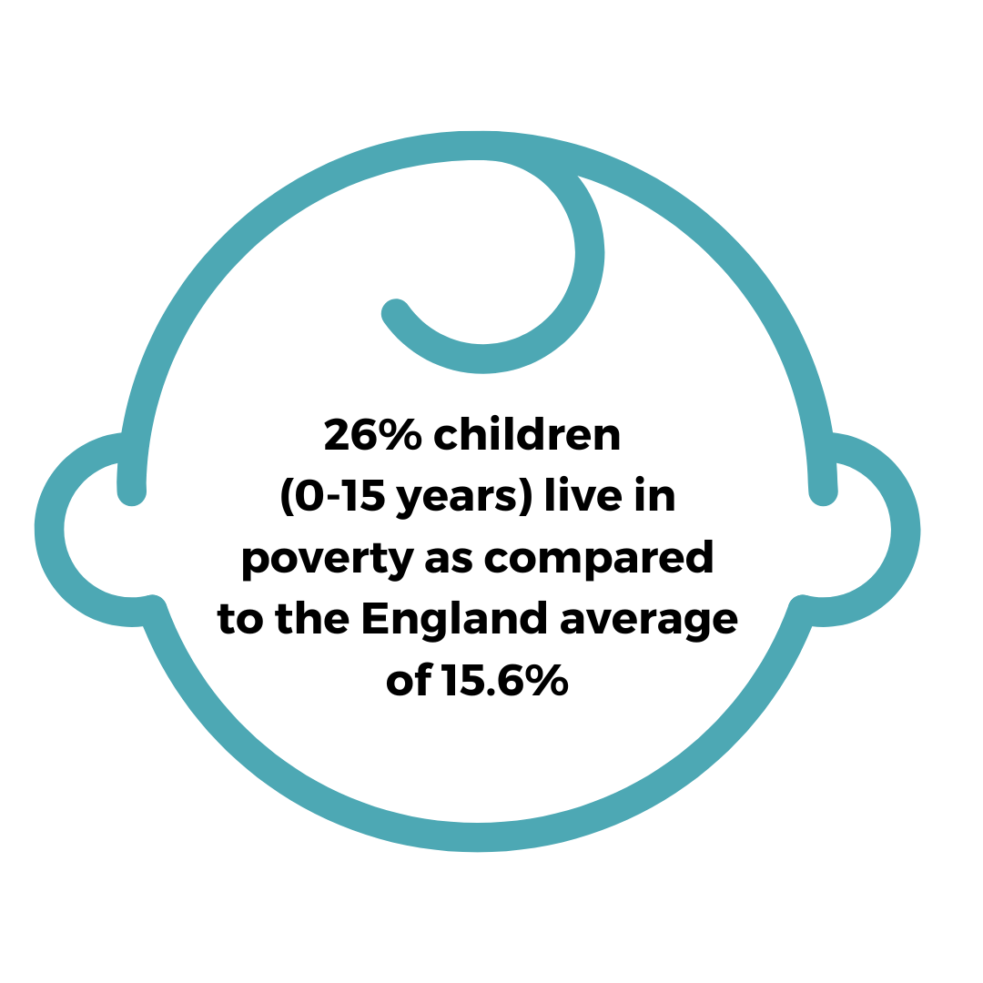
Our Population
There are long standing inequalities in health across Cheshire and Merseyside, as in the rest of England.
Women living in the most deprived areas of Cheshire and Merseyside live on average 9.5 years less than those in the least deprived.
Liverpool City has the highest numbers of asylum seeking and refugee families and who are disproportionately impacted by poverty in the Northwest region.
Women are more likely to be working in poverty and are heavily over-represented in occupations which tend to be lower paid and under-valued compared to those which are male-dominated.
Liverpool Study (Lancet, Public Health 2022) evidenced that poverty is the greatest contributor to the rising number of infants and children entering the care system.
The number of Looked After Children is 47% higher than the England average.
Women and girls have different health needs to men and manifest different disease symptoms, all too often resulting in under-treatment or misdiagnosis.
Therefore, they face different health risks and challenges throughout their lives and these risks are not simply related to reproductive health.
Inequalities in health and social outcomes exist between both men and women and between different groups of women in Cheshire and Merseyside.
Maternal suicide rates grew exponentially.
MBRACE-UK (2022) highlights how ALL Teenage Maternal Suicides had Social Care Involvement. A high number had their baby removed.
The challenges of balancing childcare, paid work and caring responsibilities with the stresses and uncertainties of the pandemic have been truly problematic for many women and have undoubtedly affected their health.

Slide 8

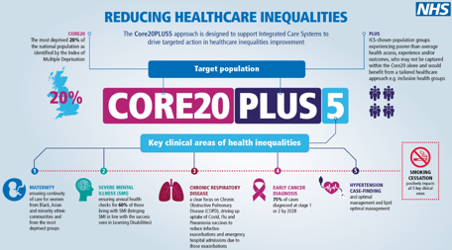
Local System Challenges - Equity and Equality Continued
How we are Responding
The National Women’s Health Strategy (2022) six-point long term plan for transformational change highlights the need to address disparities and the importance of better information and education.
The clinical areas of focus which require accelerated improvement are:-
Severe Mental illness – ensure annual health checks for 60% of those living with severe mental illness. This sits as part of the wider Mental Health programme of work.
Chronic Respiratory Disease – linking with the Cheshire and Merseyside Respiratory Network to address a number of key priorities including efforts to reduce maternal smoking.
Early Cancer diagnosis – working collaboratively with the Cheshire and Merseyside Cancer Alliance to build on best practice and implement new initiatives to prevent cancer and reduce inequalities.
Cardiovascular disease – working collaboratively with the Cheshire and Merseyside Healthcare Partnership to support communities to have the best possible cardiovascular health.
In addition to the clinical focus areas above, we recognize that smoking impacts across all the above and throughout our population generally.
In 2022 we developed our local Equity and Equality plan (which includes a focus on reducing teenage conceptions).
This was driven by local data showing a prevalence in identified areas of social deprivation areas across C&M.
“Our health and care system only works if it works for everyone. It is not right that 51% of our population are disadvantaged in accessing the care they need, simply because of their sex.” Steve Barclay, SoS for Health and Social Care

Slide 9
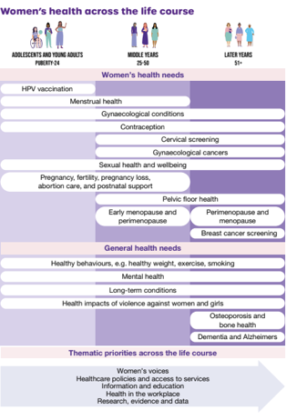
Our Commitment
Our cross-cutting principles and themes build on those articulated in the National Women’s Health Strategy:
boosted health outcomes for all women and girls, and
radical improvements in the way the health and care system engages and listens to all women and girls.
This will be achieved by:
taking a life course approach
focusing on women’s health policy and services throughout their lives
embedding hybrid and wrap-around services as best practice,
boosting the representation of women’s voices at all levels of the health and care system
An expansion of women’s health hubs improving access to and experiences of care.
Our underpinning themes over the next 3 years take the above one step further by stating our intended outcomes as:
Ensure what we do is Informed and underpinned by women’s voices
2. Increase and widening access to screening
3. Improve access and reduce delays in diagnosis
4. Deliver a better and more holistic management of conditions

Slide 10
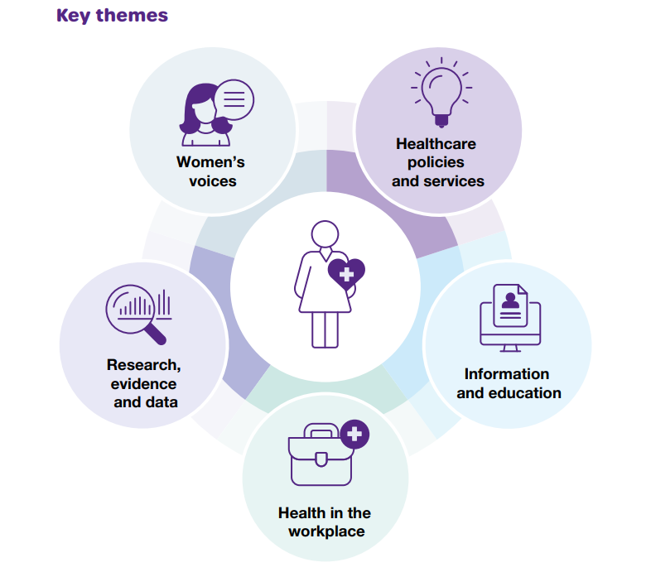
Our Vision
Through active engagement sessions, we have listened to the concerns and issues raised by local women and girls across our system to identify the key areas of focus.
Key themes
Strategy Priority Areas
We understand the status and key facts underpinning each theme.
We have listened and heard what women think and feel about each theme and feedback on the main areas of improvement and priorities.
We take a more holistic approach to women’s wellbeing by focusing on clinical conditions linked to reproductive health along with prevention of illness, promotion of wellbeing as well as treatment and management of disease.
Our priorities and actions will be delivered by:
raising awareness of women and girls’ health,
by improving access to health information and healthcare care services; and,
our commitment to reducing inequalities in health and socio-economic outcomes for women and girls, both for sex-specific conditions and in women’s general health.
Disparities in health outcomes between women
We have captured key successes achieved against each of the themes and have outlined a forward-looking 12-18 month plan for delivery.

Slide 11

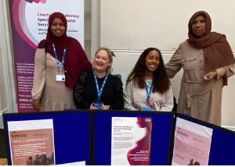
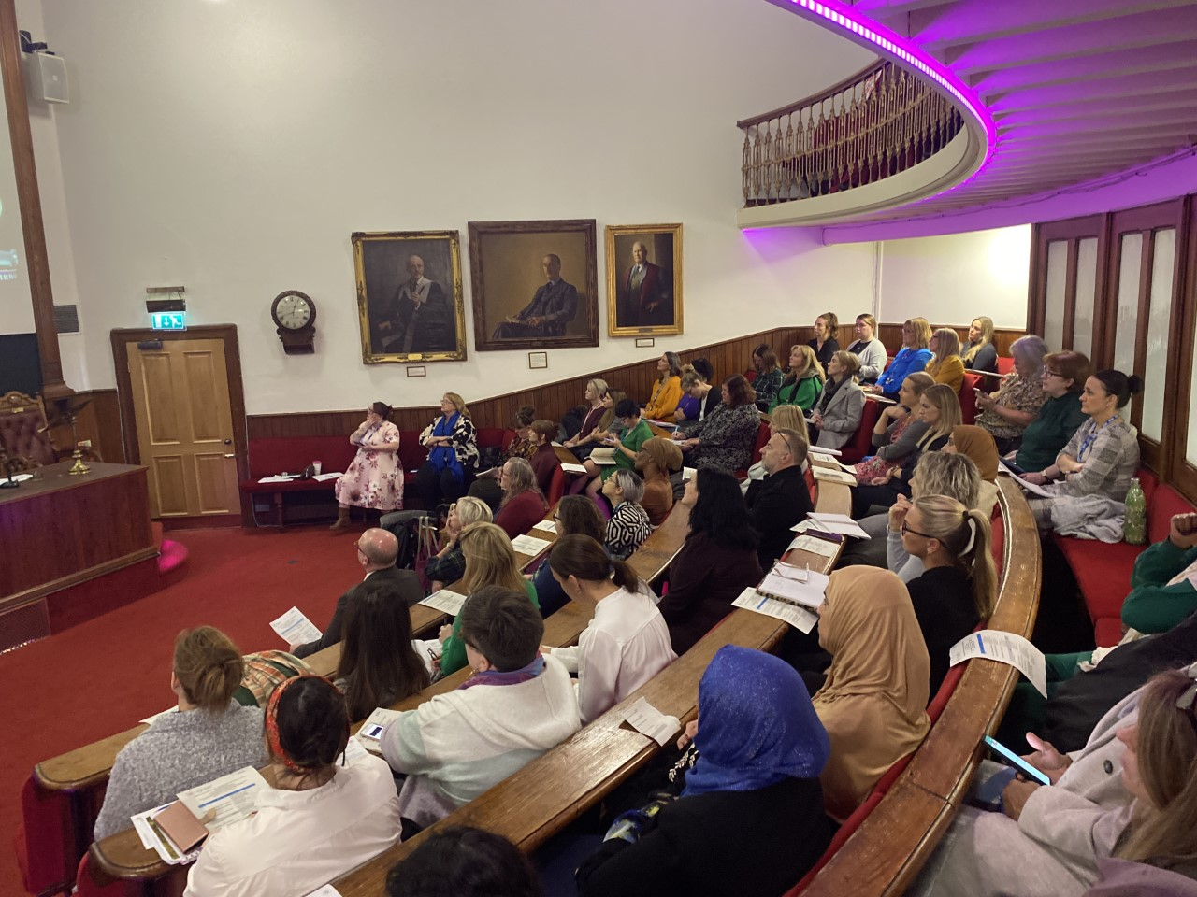
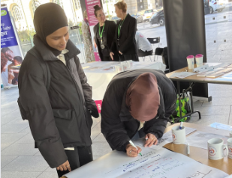
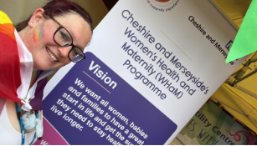
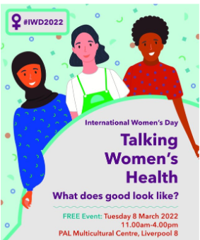
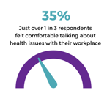
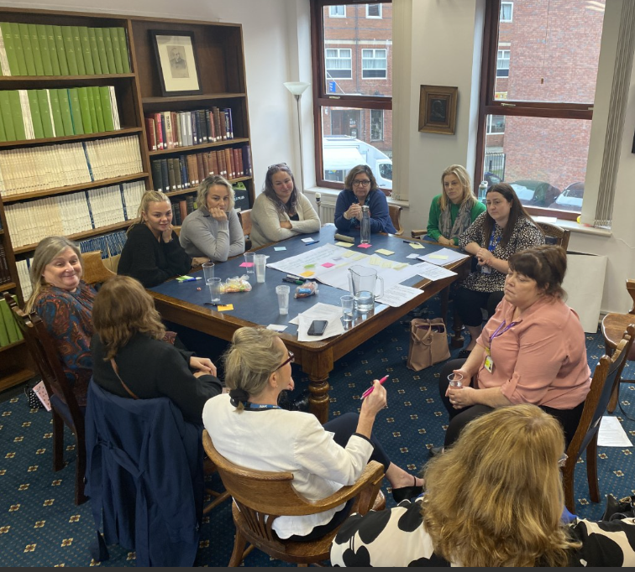
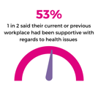
Delivering the Vision
Engagement and collaboration - Women’s and girls’ voices will be central to the development and delivery of our plan.
Demonstrating and delivering value will be essential and will link into the wider system financial strategy, ‘Efficiency at Scale’ programme.
From a patient safety perspective, it is imperative we ensure safe and effective services, and this remains a top priority. The Patient Safety Incident Response Framework will be applied and integrated within the patient safety incident response policy and plan and all elements of the National Patient Safety Strategy will be adopted.
Key Facts:
The national call for evidence highlighted that 84% of respondents stated that they had experience of not being listened to by health care professionals, throughout their health care journey from initial discussions to diagnosis.
Our local survey responses mirror the national responses. Not being listened to or taken seriously was identified as an issue by over 70% of respondents.
Growing, retaining and supporting our workforce is reflected in our workforce priorities which we plan to adopt, apply, and invest in to develop our culture, workforce, and ways of working as a system. The workforce, cultural and leadership priorities will be built into our workforce delivery plan.
“My daughter developed cancer during her pregnancy and subsequently died. Nobody took her symptoms seriously and she saw a different person every time so they could not see how she was deteriorating before their eyes”.
“As the largest employer of women in Europe, with more than one million amazing women working across every profession and discipline in health and care, the NHS has a vital role to play in the global effort to build a more equal and sustainable future”.
Chief People Officer for the NHS, Prerana Issar (8 March 2021)

Slide 12
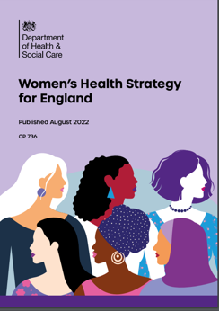

Delivering the Vision - Women’s Health Hubs
The Women’s Health Strategy for England encourages the expansion of women’s health hubs across the country improving access to and experiences of care, improving health outcomes for women and reducing health inequalities.
Women’s health hubs bring together healthcare professionals and existing services to provide integrated women’s health services in the community, at the interface between primary and secondary care. They provide intermediate care, where services are more advanced than typically seen in primary care but are for health issues which do not necessarily need a referral to secondary care. Hubs do not have to be a building or specific place; they may employ digital resources to provide virtual triage or consultations, or alternatively they may make use of existing facilities, for example GP surgeries or community centres.
In 2020 North Liverpool PCN launched the first fully integrated inter-practice Women's Health clinic for primary care in Liverpool. These clinics became the foundation of the Liverpool Women’s Health Hubs and has become a flag-ship model for many other areas developing similar services. The Liverpool hub model is delivering a significant increase in appointments and prescribing rates for Long-Acting Reversible Contraception (LARC) - both for prevention of pregnancy and managing menstrual problems.
Hubs reflect the life course approach to women’s health, where care is not limited to interventions for a single condition, but instead is wrapped around the needs of an individual woman, which in some cases may be multiple needs. For example, hubs can provide management of contraception and heavy menstrual bleeding in one visit or integrate cervical screening with other aspects of women’s healthcare such as LARC fitting or removal.
The hubs will help to meet the following system priorities:
  delivering care closer to home
  improving patient experience
  tackling health inequalities
  reducing pressure on secondary care and waiting lists

Slide 13

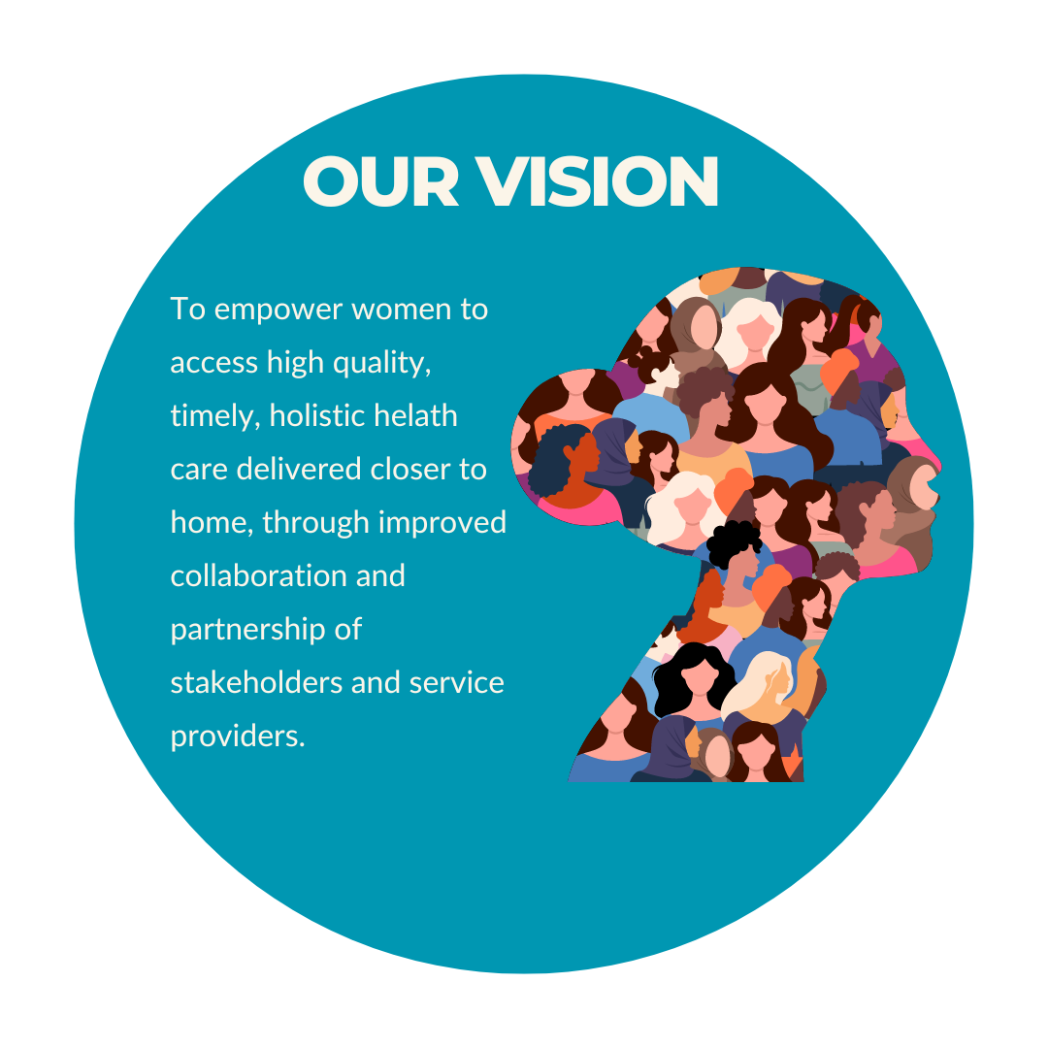
Delivering the Vision - Women’s Health Hubs
The development of Women’s Health Hubs is a key priority of our Strategy, with the aspiration to have a women’s health hub in every Place within the next 2 years, prioritising areas of highest need, i.e., low Long-Acting Reversible Contraception (LARC) use, areas of high teenage pregnancies, low access to women’s health hub provision, areas of high deprivation etc.
Across the 9 Cheshire & Merseyside Places, it is acknowledged that there are a range of services that incorporate elements of the women’s health hub within Primary Care, but with no consistency across all. This has resulted in inequity of service provision.
We aim to address this through a phased approach, focusing first on the areas of greatest need. We will design and establish a pilot approach (from July to December 2024) followed by pilot launch (January to June 2025) and evaluation. Phase 3 will commence with the rolling out of a unified approach across Cheshire and Merseyside in 2025/26.
We believe that this approach will strengthen pathways and processes, build efficiency and equity across the system and help to establish these much-needed services for women.
The core services that NHS Cheshire and Merseyside would like to see in our Women’s Health Hub development include:
  Uniform coverage across Cheshire and Merseyside of LARC devices
  LARC provision for all indications including both contraceptive and gynaecological purposes – for example heavy menstrual bleeding and endometrial protection (as part of a Hormone Replacement Therapy regime)
  Support for training in LARC procedures
  Cervical screening offer
  Screening and treatment for sexually transmitted infections (STIs) and HIV screening
”It is our long-term ambition to improve access to training and remove some of the barriers that delay access to training opportunities”

Slide 14
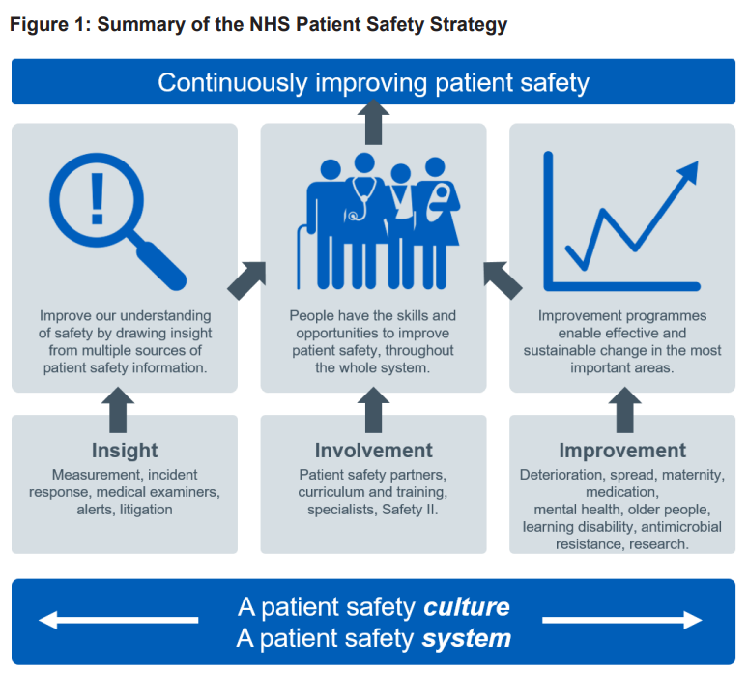
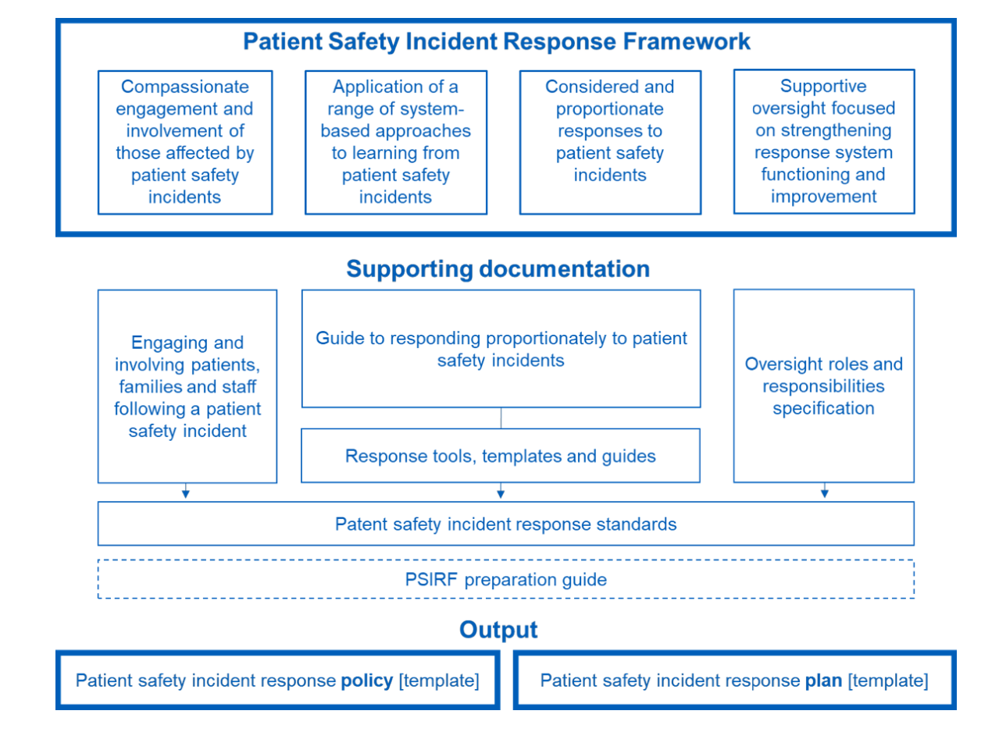
Developing and Sustaining a Culture of Safety and Service Effectiveness
The National Patient Safety Strategy was first published in 2019 and updated in 2020 and 2021. The NPSS aims to ensure NHS organisations continuously strive to improve patient safety through insight, involvement and improvement, and sets out how the NHS will support staff and providers to share safety insight and empower people – patients and staff – with the skills, confidence and mechanisms to improve safety.
The Patient Safety Incident Response Framework (PSIRF) sets out the approach to developing and maintaining effective systems and processes for responding to patient safety incidents for the purpose of learning and improving patient safety. This is an integral element of the National Patient Safety Strategy.
Across Cheshire and Merseyside ICS, the PSIRF will be applied and integrated within the patient safety incident response policy and plan. By delivering our Women’s Health Strategy and Plan, we shall work collaboratively, with a common understanding of the aims of this framework, to provide an effective governance structure which responds to patient safety incidents for the purpose of learning and improving patient safety and service effectiveness.
The Patient Safety Incident Response Framework supports the development and maintenance of an effective patient safety incident response system that integrates four key aims:
Compassionate engagement and involvement of those affected by patient safety incidents.
Application of a range of system-based approaches to learning from patient safety incidents.
Considered and proportionate responses to patient safety incidents.
Supportive oversight focused on strengthening response system functioning and improvement.
Link to Patient Safety Incident Response Framework

Slide 15
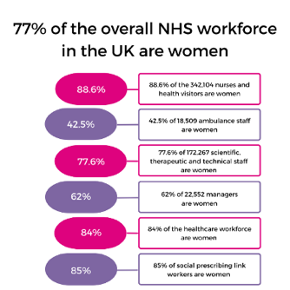
Growing, Retaining & Supporting our Workforce
With more than 1.3 million staff and three-quarters of the NHS workforce made up of women there is a clear case and welcome opportunity to address women’s reproductive wellbeing in both our own workforce as well as wider workplaces. Taken with the fact, women between the ages of 45 and 54 alone make up a fifth of all NHS employees, we can estimate up to a fifth of our workforce could be experiencing menopausal symptoms.
Six out of every 10 women experiencing menopausal symptoms say it has a negative impact on their work. Research has shown that 10% of women leave their jobs and many more are reducing their hours or passing up promotions because of their menopausal symptoms.
“As the largest employer of women in Europe, with more than one million amazing women working across every profession and discipline in health and care, the NHS has a vital role to play in the global effort to build a more equal and sustainable future”.
Chief People Officer for the NHS, Prerana Issar (8 March 2021)
We plan to adopt, apply, and invest in cultural transformation, talent management and leadership development to develop our culture, workforce, and ways of working as a system.
The workforce, cultural and leadership priorities will be built into our workforce delivery plan.
As an employer the NHS is in a key position to deliver sexual and reproductive health information and services and to support conversations which can help with a reduction in stigma and taboo, reducing the number of women leaving healthcare.
It is paramount that we take action to retain our staff. Making workplaces supportive when it comes to the perimenopause and menopause can help employees’ wellbeing and also ensure an inclusive workforce.
We believe all employers should be encouraged to design tailored workplace programmes to promote the wellbeing of female employees, ensuring that women’s lives are improved and that companies can benefit from a more effective and efficient workforce.

Slide 16
Ensuring Value
To ensure Value for Money (VFM), four criteria have been used as principles underpinning our Women’s Health Strategy and plan:
Spending less: minimising the cost
Spending well: optimising the outputs and resources used
Spending wisely: intended vs actual outcomes achieved
Spending fairly:
ensuring some people do not receive differing levels of service for reasons other than differences in their levels of need.
Economic
Efficiency
Effectiveness
Equity
Spending less
Spending well
A good example of optimising resources and demonstrating value has been the establishment of a network of Women’s Health Hubs across Liverpool’s 9 PCNs. This example was cited as a case study within the DHSC National Women’s Strategy (2022).
As part of the Cheshire and Merseyside draft interim Health Care Partnership Strategy there is a commitment to developing a system-wide financial strategy during the first half of 2023-24 to:
Determine how we will best use our resources to support reduction in inequalities, prevention of ill health and improve population health outcomes
Support health and care integration
Identify key productivity and efficiency opportunities at both a Place and ICS footprint
Outline system-wide estates and capital requirements and plans.
The ICS are focused on ensuring best value from investments and increasing the proportion of our ICB budgets allocated to the prevention of ill health.
Spending fairly
Spending wisely
The Women’s Health Strategy will link into the wider development of a system financial strategy, ‘Efficiency at Scale’ programme. One of our provider collaboratives, CMAST, is hosting the programme on behalf of the ICB which complements wider work on the ICS financial strategy and recovery plan where system partners work to reduce costs and optimise resources.

Slide 17
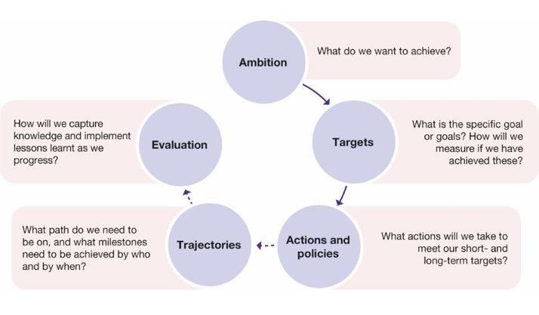
Making this happen: how we will implement our strategy and plan
Implementation Framework
We will use the framework shown above to implement our Women’s Health Strategy and Plan. This framework will enable us to:
check activities are being implemented as intended and understand how delivery has worked in reality
check that key metrics are heading in the right direction
encourage consistency across data collected by local partners to feed into an overarching picture of the progress being made
identify data gaps that have the potential to be filled by improving existing data sources or commissioning new research.

